Slide 1

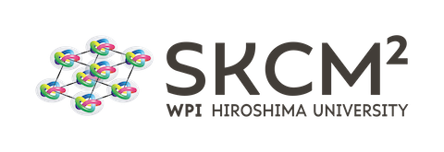

Machine Learning for Knot Invariants.
Presented by: Djordje Mihajlovic for the WPI-SKCM² winter school.
Member of TAPLab & AGQ CDT.
School of Mathematics
University of Edinburgh
Dec 2024

Slide 2
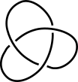


Summary.
Machine Learning.
Gaussian linking integral.
Finite Type (Vassiliev) Knot Invariants.

Slide 3
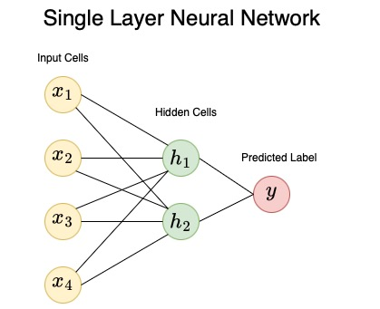
Machine Learning.
Computation is iteratively improved until classification is as accurate as possible for given input.
Some choice of input data which has a true label.
Hidden computation: computer tries to accurately classify data.

Slide 4
Machine Learning for Knot Theory.
M. Lackenby – finding relationships between different types of knot invariants¹.
Dataset: several knot invariants up to knots with 15 crossings.
Features: Knot Invariants.
Labels: Other Knot Invariants.
O. Vandans – Classifying knot conformations in polymers².
Dataset: several thousand perturbed conformations of first 5 crossing knots (using coordinate data).
Features: XYZ coordinate data of knots
Labels: Knot type.
Our Research – Classifying knot conformations.
Dataset: several thousand perturbed conformations knots.
Features: Geometric knot measures.
Labels: Knot type.
[1] Davies, A., Juhász, A., Lackenby, M., & Tomasev, N. (2021). The signature and cusp geometry of hyperbolic knots. arXiv preprint arXiv:2111.15323.
[2] Vandans, O., Yang, K., Wu, Z., & Dai, L. (2020). Identifying knot types of polymer conformations by machine learning. Physical Review E, 101(2), 022502.

Slide 5
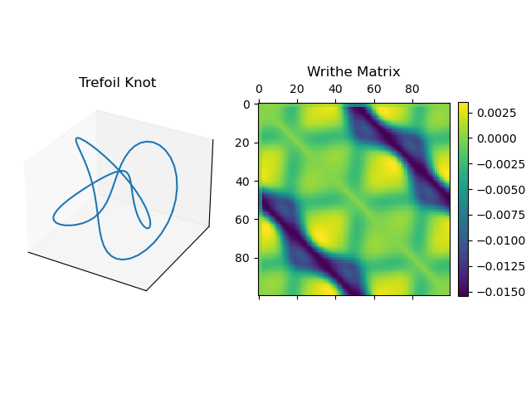
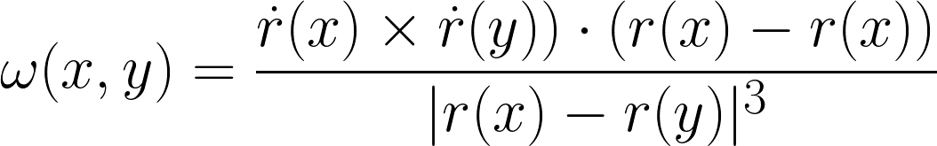
Feature: Gaussian Linking Integral³.
[3] Sleiman, J. L., Conforto, F., Fosado, Y. A. G., & Michieletto, D. (2024). Geometric learning of knot topology. Soft Matter, 20(1), 71-78.

Slide 6
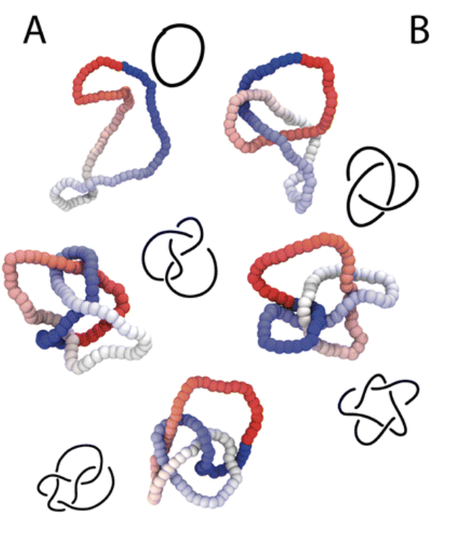
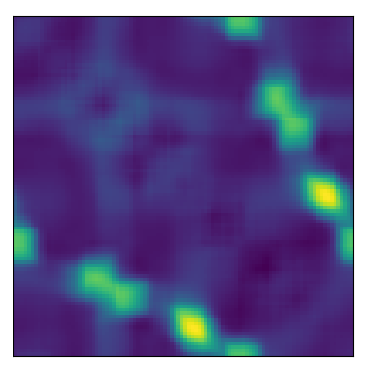
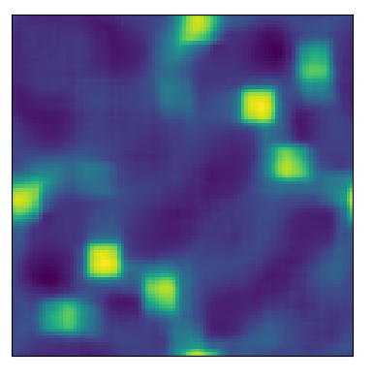
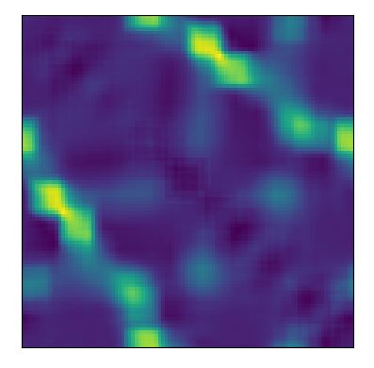
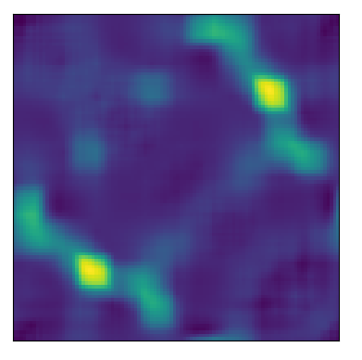
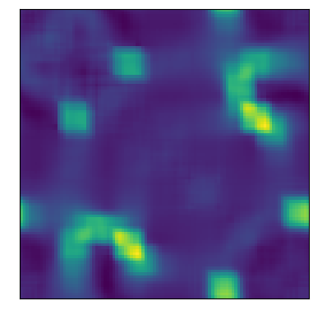
Dataset³.
…
100, 000 different configurations per knot.
…
Some 5₁ configurations in the dataset (substantial variation).
Up to 10 crossing knots.
[3] Sleiman, J. L., Conforto, F., Fosado, Y. A. G., & Michieletto, D. (2024). Geometric learning of knot topology. Soft Matter, 20(1), 71-78.

Slide 7
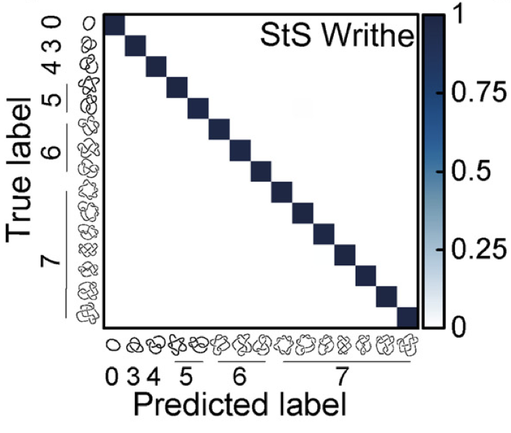
Predicting Knot Type Using Writhe Matrix³.
7 Class: classification of first 7 crossing knots.
5 Class: ~99.9%
7 Class: ~99.8%
10 (>250 knots) Class: ~95%
[3] Sleiman, J. L., Conforto, F., Fosado, Y. A. G., & Michieletto, D. (2024). Geometric learning of knot topology. Soft Matter, 20(1), 71-78.

Slide 8
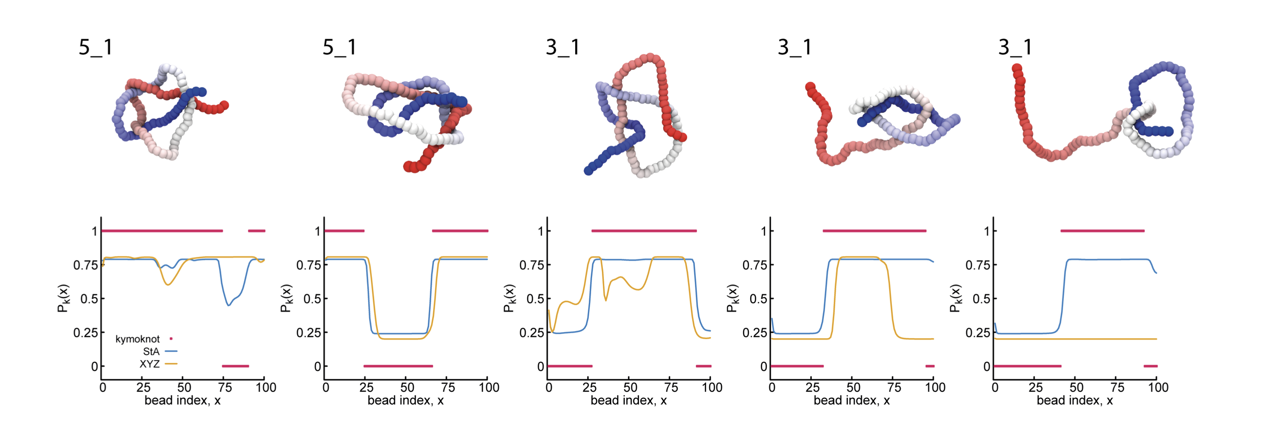
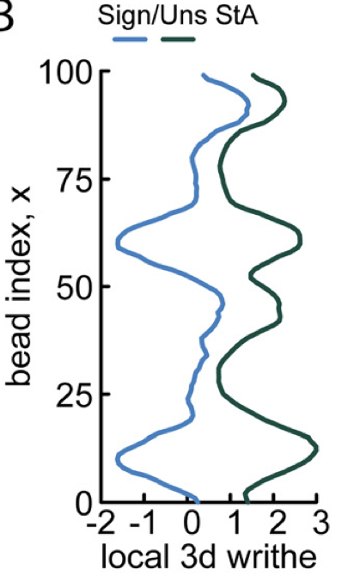
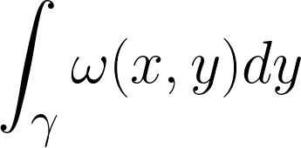
Knot Localization³.
Integral measure over writhe matrix provides classification of knot localization – naturally extends to knots on open curves.
[3] Sleiman, J. L., Conforto, F., Fosado, Y. A. G., & Michieletto, D. (2024). Geometric learning of knot topology. Soft Matter, 20(1), 71-78.

Slide 9
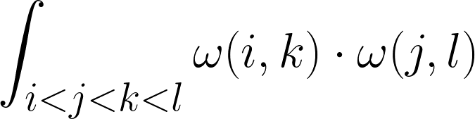
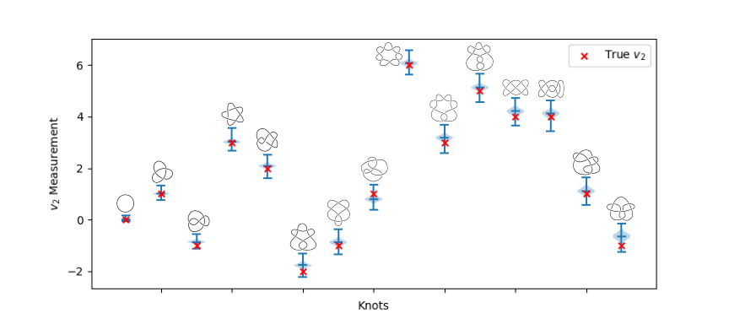
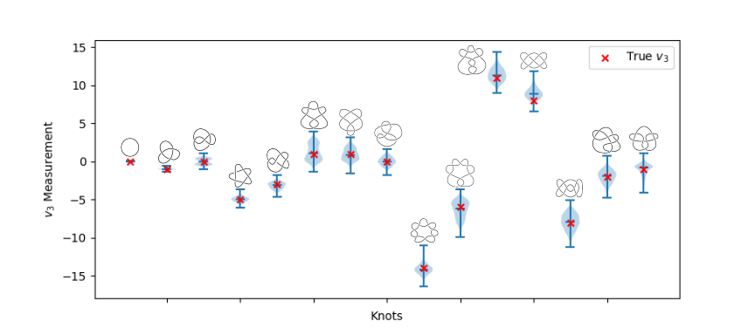
Understanding What’s Being Learned: Vassiliev Invariants⁴.
[4] Panagiotou, E., & Kauffman, L. H. (2021). Vassiliev measures of complexity of open and closed curves in 3-space. Proceedings of the Royal Society A, 477(2254), 20210440..

Slide 10
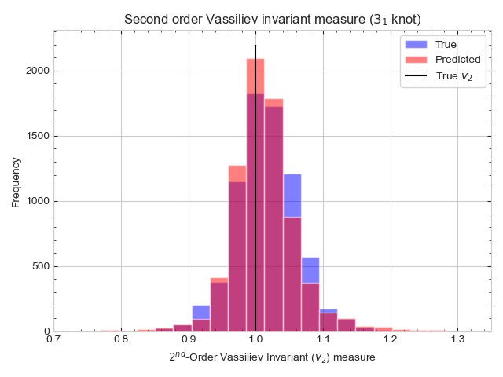
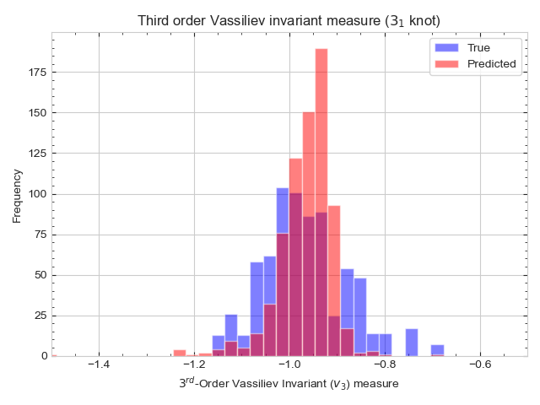
Machine Learning Capability to Learn Encoded Vassiliev Invariants.
Conclusion: Machine Learning architecture struggles to learn Vassiliev Invariants. As order increases – accuracy decreases.

Slide 11

Concluding Remarks
Neural networks can use ‘writhe matrices’ to classify knots with very high accuracy up to 10 crossings.
Vassiliev knot invariants are encoded within these writhe matrices.
Neural networks struggle to learn high order vassiliev invariants from matrix data.
Open question: what is being learned by neural networks to classify knots with such high accuracy?

